Slide 1





Modules and Routing
SPA Overview
Modules
and Routing
SoftUni Team
Technical Trainers
Software University
http://softuni.bg

Slide 2

Table of Contents
Bootstrapping
The NgModule
Creating your own modules
Routing Overview
Router Module

Slide 3
Have a Question?
sli.do #angular-js

Slide 4

Bootstrapping
Starting the application

Slide 5
Bootstrapping An Application
An NgModule class describes how the application parts fit together
Every application has at least one NgModule – the root module
It is used to bootstrap (launch) the application
Usually it is called AppModule but it is not necessary
platformBrowserDynamic().bootstrapModule(AppModule)

Slide 6
The Initial Module
import { BrowserModule } from '@angular/platform-browser';
import { NgModule } from '@angular/core';
import { AppComponent } from './app.component';
@NgModule({
declarations: [ AppComponent ],
imports: [ BrowserModule ],
providers: [],
bootstrap: [ AppComponent ]
})
export class AppModule { }
The @NgModule tells Angular how to compile and launch the app

Slide 7

Initial Module Properties
The declarations array
Only declarables – (components, directives and pipes)
The imports array
Only @NgModule classes – integrated (HttpClientModule, BrowserModule) or custom made

Slide 8

Initial Module Properties (2)
The providers array
Register service providers and inject them into components
The bootstrap array
The root component – used to launch the application
Inserting a bootstrapped component usually triggers a cascade of component creation

Slide 9

The NgModule
Creating your own modules

Slide 10
Angular Modules Overview
NgModules help organize an application into cohesive blocks of functionality.
An NgModule is a class decorated with @NgModule
Many Angular libraries are NgModules
FormsModule, HttpClientModule, RouterModule
Many third-party libraries are available as NgModules
Material Design, Ionic, Angular Fire
import { NgModule } from '@angular/core';

Slide 11
Creating Custom Modules
Creating you own modules is useful when the application grows
Only the root module should contain BrowserModule
All custom made modules should import CommonModule
Custom made modules have exports array
Components added in declarations are private by default
This is done because of reusability.
import { CommonModule } from '@angular/common';

Slide 12
Creating Cutom Modules (2)
import { NgModule } from '@angular/core';
import { CommonModule } from '@angular/common'; @NgModule({
imports: [ CommonModule ],
declarations: [ CustomerCreateComponent, CustomerListComponent,
CustomerDetailsComponent],
exports: [ CustomerListComponent ],
providers: [ CustomersService ]
})
export class CustomersModule {}
Export the component in order to render it outside this module

Slide 13
Suggested Common Module
Shared Module - to contain all common components, directives and pipes used by a lot of places
Core Module – to contain singleton services and components needed only once in the application
Authentication Module (Register, Login, Logout)
Feature Module – to contain feature specific components
More info: https://angular.io/guide/ngmodule

Slide 14
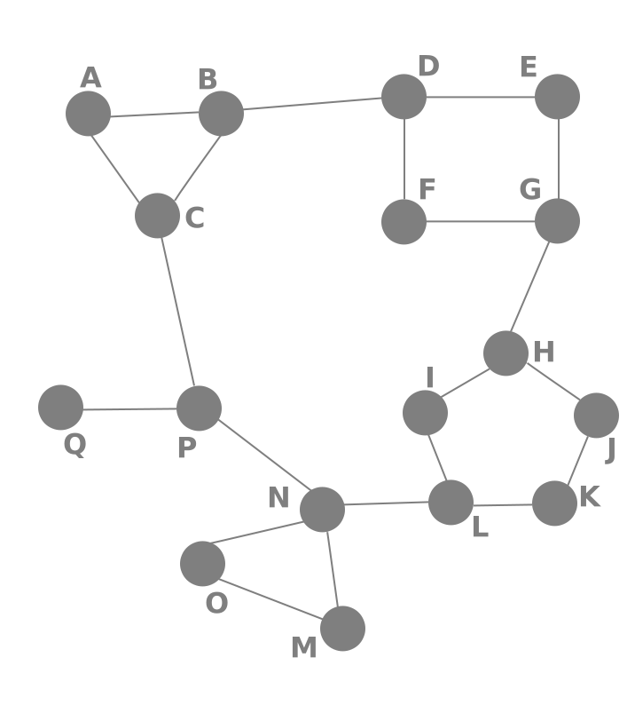
Routing Overview
Navigation for Single Page Apps

Slide 15


What is Routing?
Routing allows navigation, without reloading the page
It's a pivotal element of writing Single Page Applications
Link
HTML
Router
Link
Link
Link
Standard Navigation
Navigation using Routing

Slide 16

Single Page Applications
A Router loads the appropriate content when the location changes
E.g. when the user manually enters an address
Conversely, a change in content is reflected in the address bar
E.g. when the user clicks on a link
Benefits:
Load all scripts only once
Maintain state across multiple pages
Browser history can be used
Build User Interfaces that react quickly

Slide 17

Router Module
Basic Routing in Angular

Slide 18
Define the Template
First add the base meta tag into the index.html file
Add a nav tag so the user can navigate through the app
Define the router outlet where the content will be rendered
<base href="/">
Usually added by the CLI
<nav>
<a routerLink="/home">Home</a>
<a routerLink="/about">About</a>
</nav>
<router-outlet></router-outlet>

Slide 19
Create Routes Module
Import NgModule, RouterModule and Routes
Define the needed routes as an array of objects
import { NgModule } from '@angular/core'
import { RouterModule, Routes } from '@angular/router';
const routes: Routes = [
{ path: 'home', component: HomeComponent },
{ path: 'about', component: AboutComponent } ]
'/' not needed infront!

Slide 20
Create Routes Module (2)
Define the App Routes Module using the decorator
@NgModule({
declarations: [
HomeComponent,
AboutComponent
],
imports: [RouterModule.forRoot(routes)],
exports: [RouterModule]
})
export class AppRoutesModule { }
Registers all app routes (done only once)

Slide 21
Create Routes Module (3)
Finally import the routes module in app module
import { AppRoutesModule} from './routes.module.ts'
// Other imports for core module
@NgModule({
declarations: [ AppComponent ],
imports: [
BrowserModule,
AppRoutesModule,
],
export class AppModule { }

Slide 22
Redirecting From a Path
Sometimes it is useful to redirect to a specific path
For example the default route should redirect to home
const routes: Routes = [
{ path: 'home', component: HomeComponent },
{ path: '', redirectTo: 'home', pathMatch: 'full'}
{ path: 'about', component: AboutComponent } ]
The placement order of the routes matters!

Slide 23



Using Wildcards
If the requested URL doesn't match any paths for routes, show a 404 Not Found Page
This is done by using a wildcard '**'
{ path: '**', component: PageNotFoundComponent }

Slide 24
Route Parameters
To take a parameter from the url:
After that inject Activated Route in the Component and extract the id
{ path: 'courses/:id',component: CourseDetailsComponent }
export class CoursesComponent {
public paramsId : string; constructor(
private route : ActivatedRoute
) { this.paramsId = this.route.snapshot.params['id']; } }

Slide 25
Router Additional Functionality
Children routes
Secondary routes
Guards
Handle unauthorized requests
Lazy Loading and more: https://angular.io/guide/router
children: [ { path: '/create', component: CreateComponent } ]

Slide 26

Summary
Every Angular application has a root module
NgModules help organize an application
Routing allows navigation without reloading the page
The Router Module in Angular is a powerful tool
It supports Basic Routing, Routing with parameters, Child Routes, Route Guards and more
import { NgModule } from '@angular/core'

Slide 27







JavaScript Web – Angular Fundamentals
https://softuni.bg/courses/

Slide 28
License
This course (slides, examples, demos, videos, homework, etc.) is licensed under the "Creative Commons Attribution-NonCommercial-ShareAlike 4.0 International" license
Attribution: this work may contain portions from
"End-to-end JavaScript Applications" course by Telerik Academy under CC-BY-NC-SA license

Slide 29





Trainings @ Software University (SoftUni)
Software University – High-Quality Education, Profession and Job for Software Developers
softuni.bg
Software University Foundation
http://softuni.foundation/
Software University @ Facebook
facebook.com/SoftwareUniversity
Software University Forums
forum.softuni.bg

